Slide 1

Google Data Analytics: COVID-19
University at Buffalo
CDA502LECF1S:Database Management Systems
Project by :
Rohit Tananki

Slide 2
Agenda
Objective
3
Introduction about Dataset
4
Preview Data
5
Insights
6-12
Conclusion
13

Slide 3
Objective :
In this project we look at trends that occurred during the Covid-19 pandemic so that we are prepared for such uncertain events that might occur in the future.
•Looked at trends such as Effect of Vaccine vs No of Cases
•Effect of Vaccine vs No of Deaths Occurring
•How policies such as closing of schools and workplaces curbed the spread of the infection
•Looked at density of cases by area to assess areas of high risk Through our research, we hope to identify a few steps that can be taken to help prevent the rapid spread of such deadly infection in the future .

Slide 4
Introduction about Dataset
3
In this data set we have cleaned the data and prepared the data perform gain insights and perform analysis.
We first started out by removing the null values in our data
We created variables to help draw insights. We created case_num to count the occurrences of new cases, vaccine_num for number of vaccines, death_num for number of deaths ,these variables have been created by using sum and group by functions .
We have plotted the density of cases on a bubble plot and to achieve this we gad to create a location variable which had the latitude and longitude we did this using the concat function
Other data points in our analysis explore the various demographics of the people affected by covid

Slide 5
Preview Data
Age group: Different age groups 0-10, 11-20, 21-30, 31-40, 41-50, 51-60 which were affected with covid
workplace closing: A numeric code signifying the closing of workplaces (0 = No measures 1= recommend Closing,2= require closing or work from home for some sectors or categories of workers,3 = Requires closing for all).
school closing: A numeric code signifying the closing of schools. (0 = No measures 1= recommend closing ,2= require closing or work from home for some sectors,3 = Requires closing for all).
country name: The names of different countries worldwide which were affected with covid
male: The number of male populations affected with covid
female: The number of Female populations affected with covid
location: Created variable using Latitudes and Longitudes
vaccine num: Sum of no. of vaccines according to date
case sum: Sum of no. of cases according to date(month)
death num: Deceased, Number of deaths according to date.

Slide 6
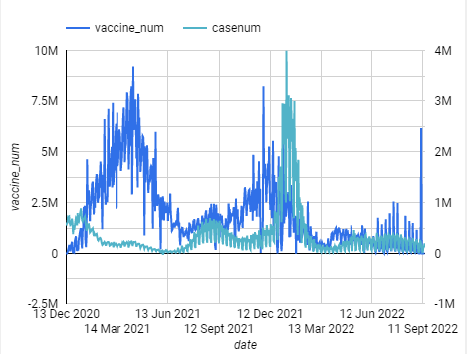
Insight 1
we find that with the introduction of the vaccine we find a sharp decrease in the number of cases.
A spike in cases there is also a spike in the number of vaccines. where again much of the increase occurs during the second wave.

Slide 7
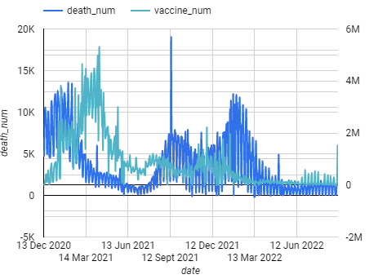
Insight 2
1. We find a sharp decline with the number of deaths as the numbers of vaccines administered are increased .
2. As vaccines drop we don’t see a spike in deaths again until the second wave that occurred where we find that the number of vaccines pick up as soon as there is a spike in the number of deaths.

Slide 8
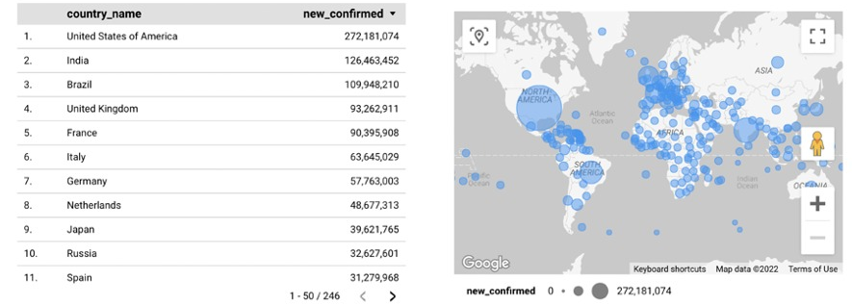
Insight 3
Global covid-19 tracker:
The global map tracker provides the total number of confirmed cases of novel coronavirus by country .
The bigger circle shows high concentration of cases, and we can see that the urban civilization has a greater number of cases
With this tracker , we are able to determine the global spread of the disease throughout the world and by country and hence the coronavirus was declared a pandemic else we would have just considered this to just be an epidemic within a certain region /country

Slide 9
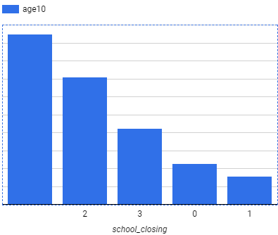
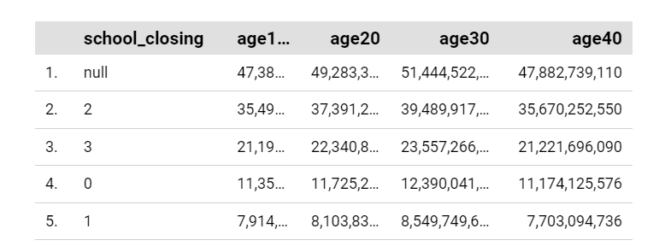
Insight 4
School closing :
How are the age groups 10 and lesser affected with the school closures in effect?
Positive cases were high in the areas where school closure was in effect maximum and less where there were less to no restrictions
This makes sense as to why the school closures were imposed in such areas.
0 = No measures
1= recommend closing ,
2= require closing or work from home for some sectors,
3 = Requires closing for all

Slide 10
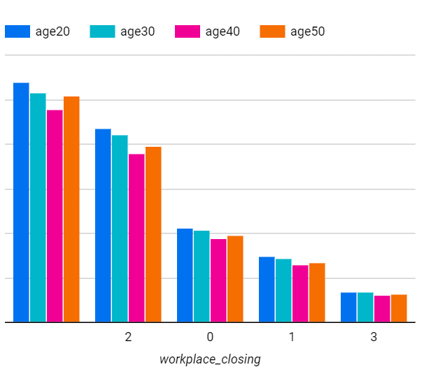
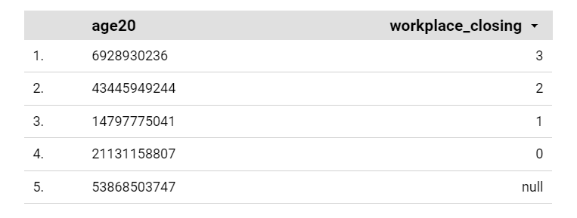
Insight 5
Workplace closing:
How are the different age groups affected with the workplace closures in effect?
The most affected age groups in USA irrespective of the workplace closing are the ages 20-30 and 50-59. Least number of positive cases in all the age groups have been observed where all the workplaces have been completely closed.
Intuitively a decreasing trend can be observed with the workplace closure restrictions in place.
0 = No measures
1= recommend closing ,
2= require closing or work from home for some sectors,
3 = Requires closing for all

Slide 11
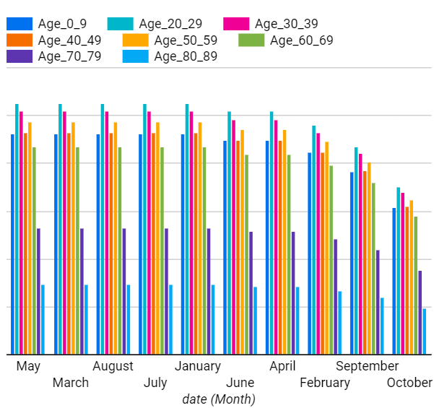
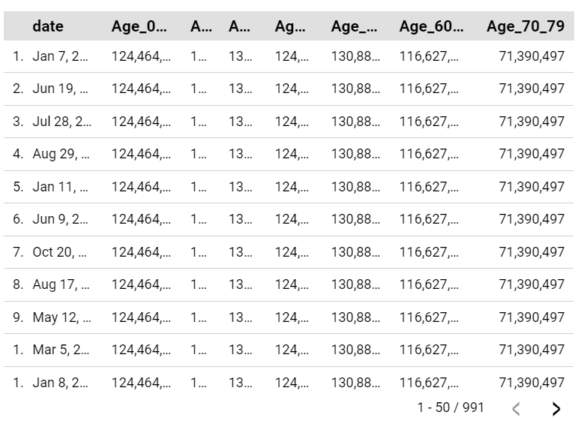
Insight 6
Highest number of positive cases based on months and age
How are different age groups affected with covid during certain periods (month).
We can able to see which age group are affected the most

Slide 12
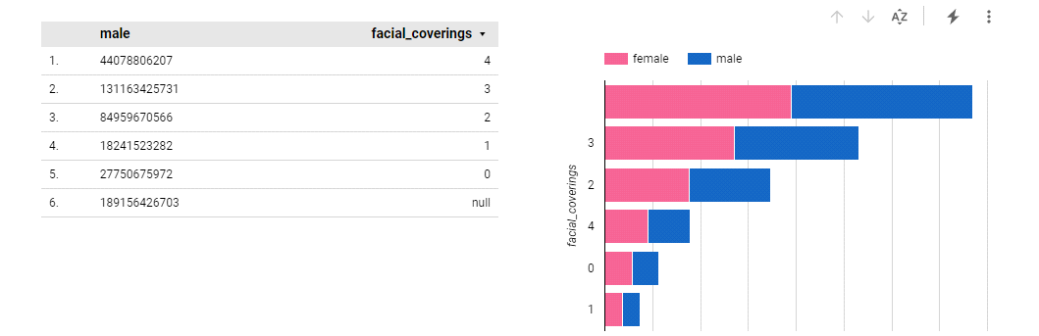
Insight 7
3
The below graph gives an outlook on the number of people in millions who contracted covid. The numbers 0,1,2,3,4 tell us how much necessity there was to wear the mask. The maximum number tells us that the necessity of wearing the mask was less. And from this graph, we can understand that females have slightly got more covid than males.

Slide 13
Conclusions
It talks about how we used the dataset and have written the queues to get the visualization of what points we need to understand better about the pandemic that has happened.
From the data, we can get the visualization for the population, school closing, workplace closing, vaccine vs death, case vs vaccine as well as people wearing masks.
From the visualization, we can understand that the number of cases increased at the start but came down when the vaccines came into the picture. But then it increased when people slowed on getting the vaccines and got into control when they started to take the vaccines.
A few things we would like to mention that helped control Covid were working from home and closing the schools and workplaces down, which didn't have the necessary attendance in such a hazardous time.

Slide 14
Acknowledgment
We would like to express our deep gratitude to Professor Charles Border, for his patient guidance, enthusiastic encouragement and useful critiques of this Subject. I would also like to thank him for his advice and assistance in keeping our progress on schedule.
Thank you

